Slide 1

PureNet Pi
By: Xavier Christian
Chance Foster

Slide 2
Project overview
PureNet Pi is a custom-built DNS firewall solution using Python and Raspberry Pi.
It combines DNS-level domain blocking with SSH-based IP-level firewall management.
Users interact via a simple CLI to add, remove, check, or list blocked domains or IPs.

Slide 3
Key features
Custom Python DNS server using dnslib
• Block domains using a local DNS resolver
• Block IPs via SSH and iptables on a remote Pi firewall
• Query logging for DNS requests
• Interactive command-line interface
• Blocklist persistence in text files
• Blocked IP's and Domains are stored in text files that DNS Pi will refer to when showing what sites and devices are allowed

Slide 4
Architecture
1. DNS Pi: Resolves DNS requests, blocks based on domain/IP lists
2. Firewall Pi: Accepts SSH commands to apply or remove IP blocks with iptables
3. Client devices use the DNS Pi as their DNS resolver
4. Logs DNS activity to a local file for visibility

Slide 5
Use-Case and workflow
User runs the DNS firewall manager on the DNS Pi
• Commands like 'add-site', 'add-ip' , 'remove-site', and 'remove-ip' modify the blocklists and firewall rules
• DNS queries are intercepted and filtered
• IPs added are blocked on the network by the firewall Pi
• All activity is logged
Upon entering the internet the sites already on each block list will be already blocked so since both the firewall and DNS Pi start up automatically

Slide 6
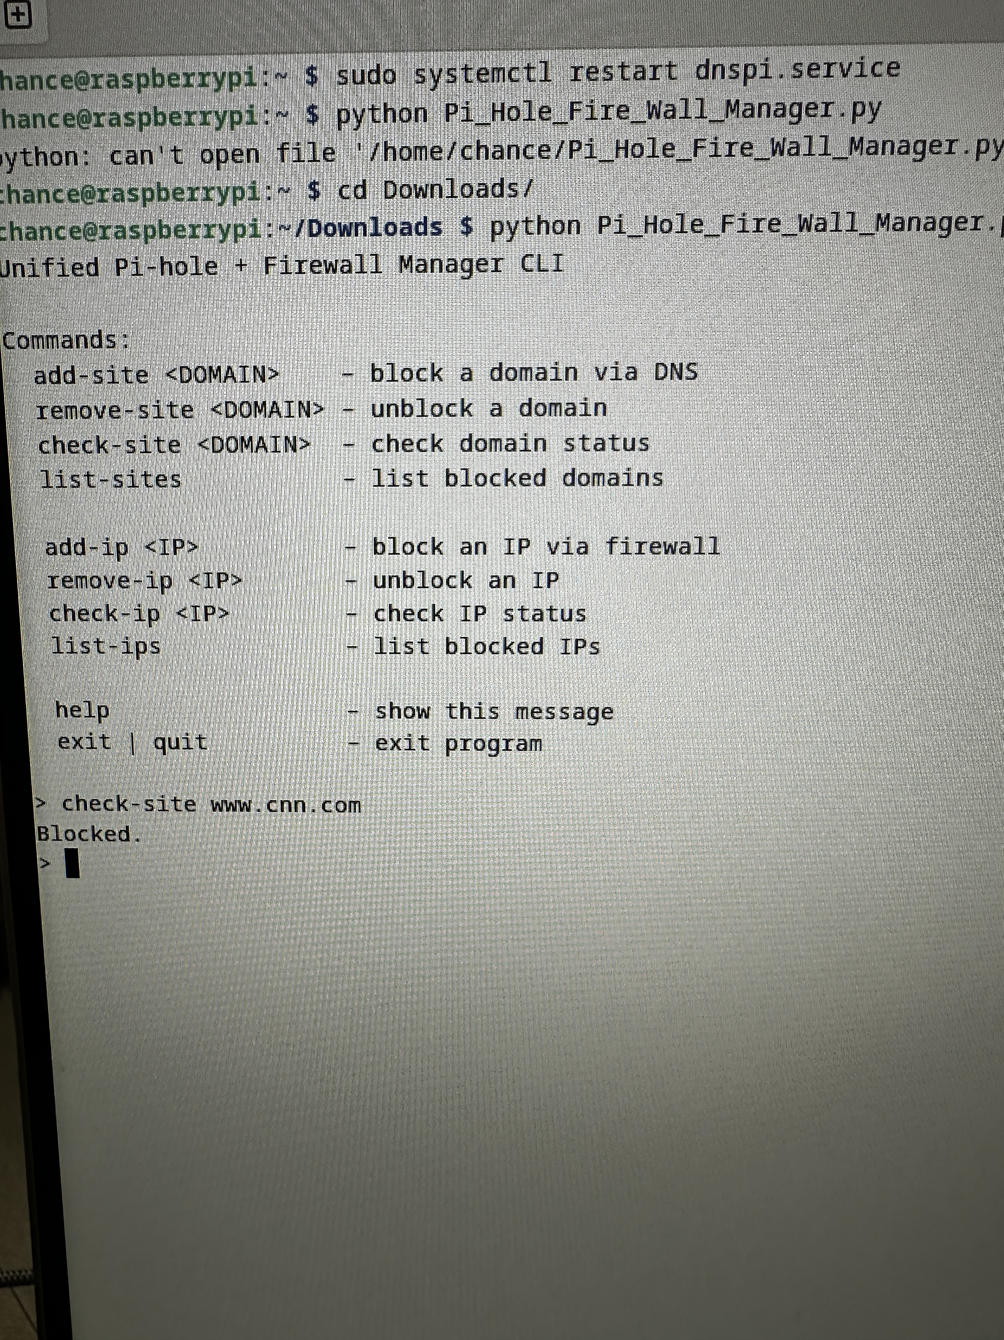
Photo of interface

Slide 7
Regular Pi-Hole vs Purenet Pi
Pi-Hole
Purenet Pi
• Prebuilt GUI solution
• DNS-based blocking only
• Lacks integrated firewall rules
• Fully coded from scratch in Python
• Includes both DNS and firewall functionality
• CLI-based control
• More user functionality as users can add and remove as they choose

Slide 8
Future improvements
Creating a web interface that would allow users to access the DNS-Pi functions without going into the terminal
Allowing downloadable blocklist allowing all blocked things to be put in different save list.
Finding a way to not have to reset the DNS-Pi in order to for the blocked domain or IP to be added

